Slide 1


Sybex CCENT 100-101
Chapter 1: Internetworking
Instructor & Todd Lammle

Slide 2

Chapter 1 Objectives
The CCENT Topics Covered in this chapter include:
Operation of IP Data Networks
Recognize the purpose and functions of various network devices such as Routers, Switches, Bridges and Hubs.
Select the components required to meet a given network specification.
Identify common applications and their impact on the network.
Describe the purpose and basic operation of the protocols in the OSI and TCP/IP models.
2

Slide 3
Figure 1.1: A Very Basic Network
This figure shows a basic local area network (LAN) that’s connected using a hub, which is basically just an antiquated device that connected wires together.
Hub: when received a frame from one port, hub will copy the packet and broadcast it to all the other ports.

Slide 4
Hub
When hubs receive an electrical signal in one port, the hub repeats the signal out all other ports.
When two or more devices send at the same time, an electrical collision occurs, making both signals corrupt.
As a result, devices must take turns by using carrier sense multiple access with collision detection (CSMA/CD) logic, so the devices share the (10-Mbps) bandwidth.
Broadcasts sent by one device are heard by, and processed by, all other devices on the LAN.
Unicast frames are heard by all other devices on the LAN.

Slide 5
Figure 1.2: A switch can break up collision domains
This figure shows a network that’s been segmented with a switch, making each network segment that connects to the switch its own separate collision domain. Doing this results in a lot less yelling!
Switch: keep a track of MAC address and the corresponding port, so when received a frame, it will look up the map and forward it to the specific system.

Slide 6
Switch
Switches separated devices into groups called collision domains.
Switches reduced the number of collisions that occurred in the network, because frames inside one collision domain did not collide with frames in another collision domain.
Switches increased bandwidth by giving each collision domain its own separate bandwidth, with one sender at a time per collision domain.
Bridge is a simple version or predecessor of switch, which can break up a network into 2 collision domains.

Slide 7
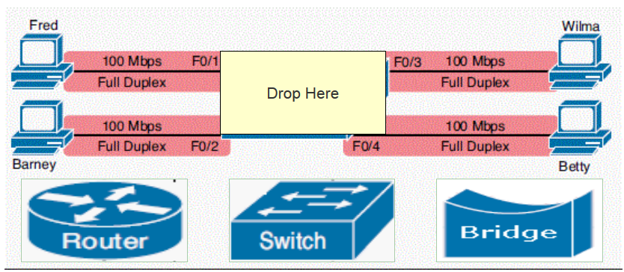
In class practice 1
Create four collision domains with the ability to send data in a speed of 100Mb/s at each link. Please drag one device in the figure below.
Hub

Slide 8
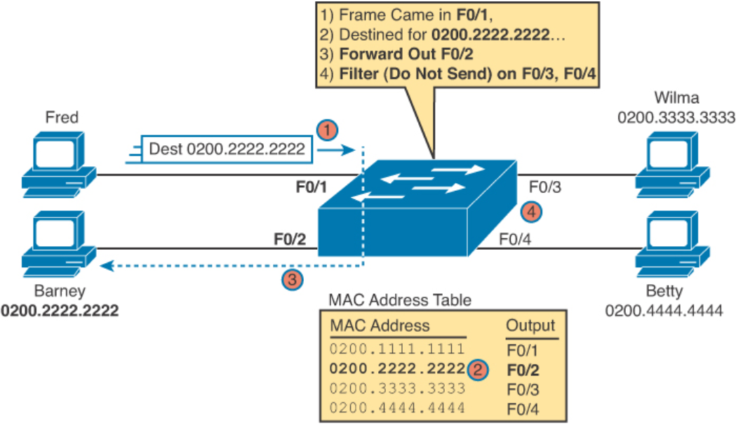
Switch
Compare the destination with the MAC table and determine forward the packet

Slide 9
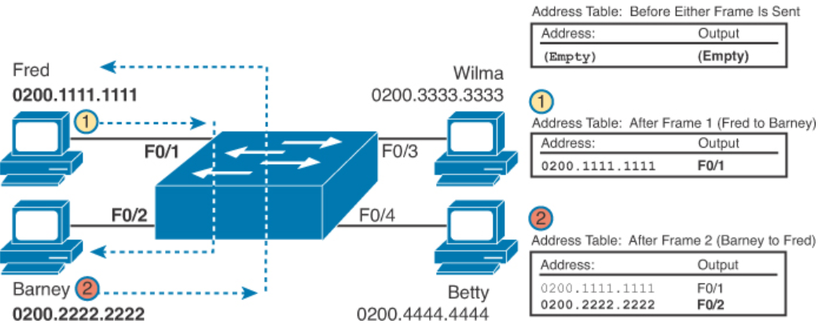
Learning Switch
Switches build the address table by listening to incoming frames and examining the source MAC address in the frame. If a frame enters the switch and the source MAC address is not in the MAC address table, the switch creates an entry in the table.

Slide 10
Learning Switch
How does the first packet arrive at Barney’s?
Flooding: Switches flood unknown unicast frames (frames whose destination MAC addresses are not yet in the address table). Flooding means that the switch forwards copies of the frame out all ports, except the port on which the frame was received.

Slide 11
Figure 1.3: Routers create an internetwork
This figure depicts a router in our growing network, creating an internetwork and breaking up broadcast domains.
Router: sit between two different networks, and route packets from one network to another.

Slide 12
Hub v.s. Switch v.s. Router
Hub and switch are layer 2 devices, while router is layer 3 device.
Hub just simply connects devices and broadcasts anything it receives, so everything is in the same collision domain and broadcast domain. Low bandwidth.
Switch breaks up collision domain, but still in the same broadcast domain.
Router does not forward broadcast by default, it breaks up both collision and broadcast domains.

Slide 13
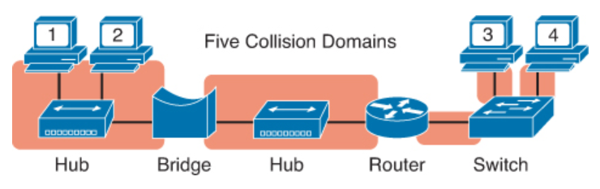
Collision Domain
Originally, the term collision domain referred to an Ethernet concept of all ports whose transmitted frames would cause a collision with frames sent by other devices in the collision domain.

Slide 14
Collision Domain
For a single collision domain:
The devices share the available bandwidth.
The devices might inefficiently use that bandwidth because of the effects of collisions, particularly under higher utilization.
Consider a design with ten PCs, with each link using 100Mbps. With a hub, only one PC can send at a time, for a theoretical maximum capacity of 100 Mbps for the entire LAN. Replace the hub with a switch, and you get
100 Mbps per link, for a total of 1000 Mbps (1 Gbps)
The ability to use full-duplex on each link, effectively doubling the capacity to 2000 Mbps (2 Gbps)

Slide 15
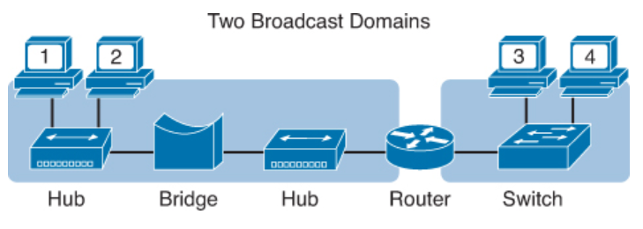
Broadcast Domain
Routers breaks up broadcast domain, while hubs and switches do not

Slide 16
Figure 1.4: Internetworking devices
Figure 1.4 shows how a network would look with all these internetwork devices in place. Remember, a router doesn’t just break up broadcast domains for every LAN interface, it breaks up collision domains too.

Slide 17
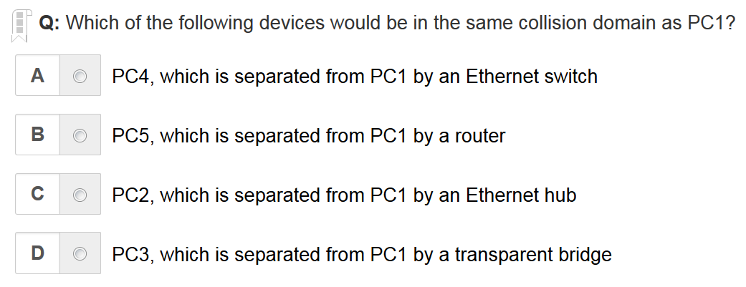
In class practice
C is the correct answer

Slide 18
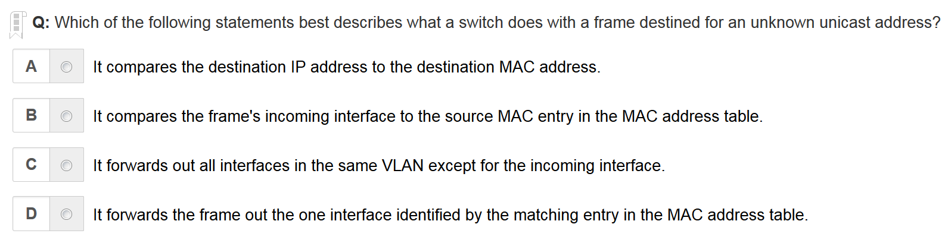
C is the correct answer

Slide 19
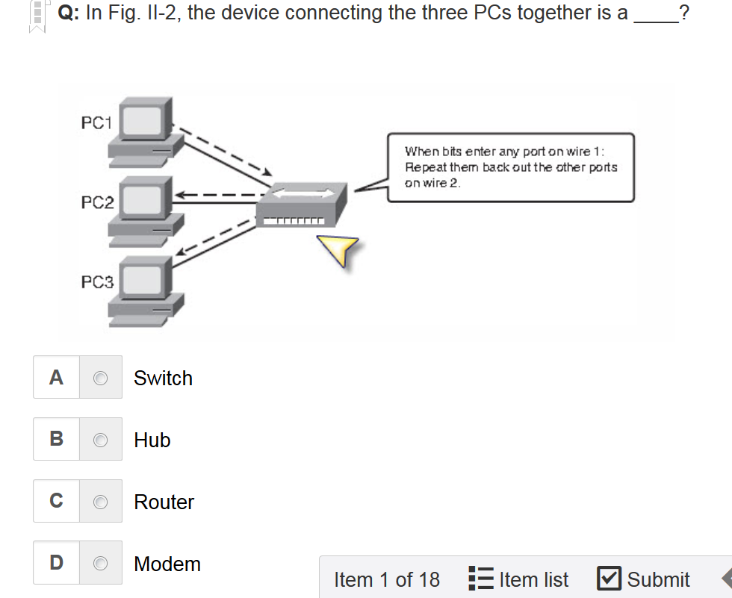
B is the correct answer

Slide 20
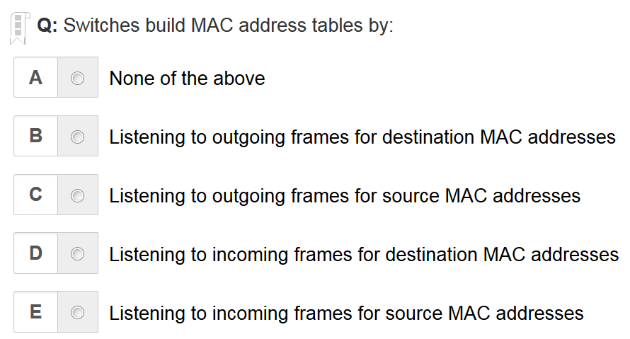
E is the correct answer

Slide 21
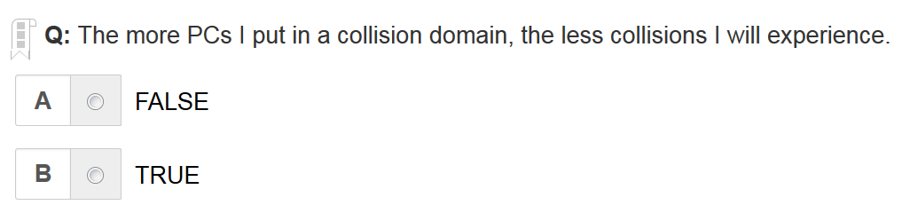
A is the correct answer

Slide 22
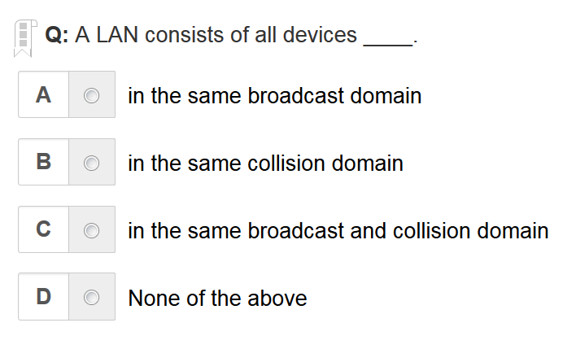
A is the correct answer

Slide 23
Figure 1.6: The upper layers Figure 1.7: The lower layers

Slide 24
Figure 1.8: OSI layer functions
This figure seperates the 7-layer model into three different functions. The upper layers, the middle layers and the bottom layers. The upper layers communicate with the user interface and application, the middle layers do reliable communication and routing to a remote network, and the bottom layers communicate to the local network.

Slide 25
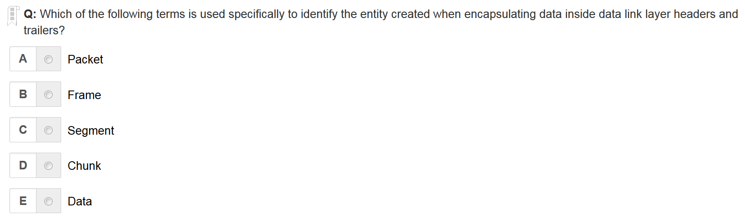
B is the correct answer
Segment is in transport layer
Packet is in network layer
Frame is in data link layer

Slide 26
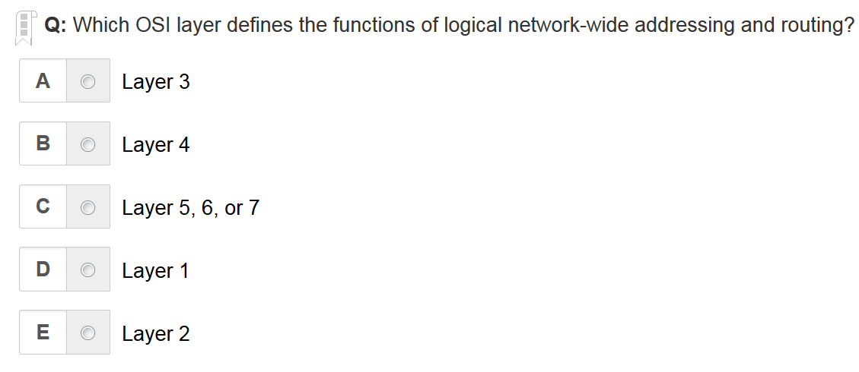
A is the correct answer

Slide 27
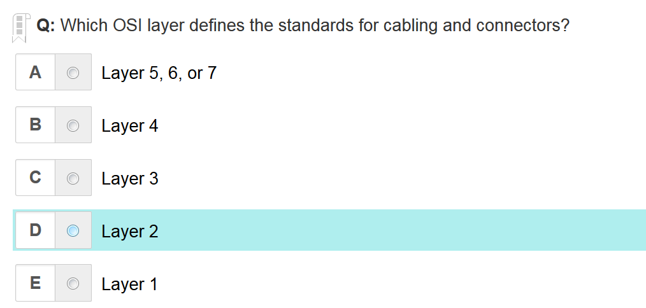
E is the correct answer

Slide 28
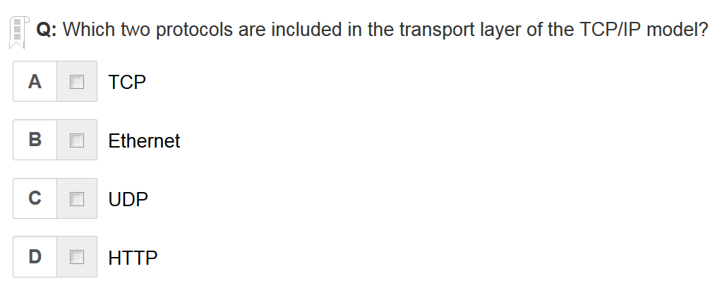
A C are the correct answers

Slide 29
Figure 1.9: Establishing a connection-oriented session
This figure depicts a typical reliable session taking place between sending and receiving systems. In it, you can see that both hosts’ application programs begin by notifying their individual operating systems that a connection is about to be initiated.

Slide 30
Figure 1.10: Transmitting segments with flow control
Receivers controls senders not to transmit too much.

Slide 31
Figure 1.11: Windowing
If you’ve configured a window size of 1, the sending machine will wait for an acknowledgment for each data segment it transmits before transmitting another one but will allow three to be transmitted before receiving an acknowledgement if the window size is set to 3.

Slide 32
Figure 1.12: Transport layer reliable delivery
In the figure, the sending machine transmits segments 1, 2, and 3. The receiving node acknowledges that it has received them by requesting segment 4 (what it is expecting next).

Slide 33
Figure 1.13: Routing table used in a router
A packet from network 1 to network 3 will be first processed by the router in the left, since the destination is to network 3, so it will be forwarded to interface “S0”, when it reaches the router in the right, it will be forwarded to interface “E0” since network 3 corresponds to interface “E0”

Slide 34
Figure 1.14: A router in an internetwork
Each router LAN interface is a broadcast domain. Routers break up broadcast domains by default and provide WAN services.
Routers, by default, do not forward broadcast packets;
Routers use logical addresses, e.g., IP, to determine next hop to forward packets;
Routers can use access lists to provide security control;

Slide 35
Figure 1.16: A switch in an internetwork
Figure 1.16 shows a switch in an internetwork and how John is sending packets to the Internet and Sally doesn’t hear his frames because she is in a different collision domain.

Slide 36
Figure 1.17: A hub in a network
Figure 1.17 shows a hub in a network, and how when one host transmits, all other hosts must stop and listen

Slide 37
Layer 3 v.s. Layer 2 devices
Layer 3 devices, e.g., routers, need to locate specific networks using logical addresses such as IP;
Layer 2 devices, e.g., switches, need to locate specific devices using MAC addresses;

Slide 38
Written Labs and Review Questions
Read through the Exam Essentials section together in class
Open your books and go through all the written labs and the review questions.
Review the answers in class.
38

